Slide 1


CRM & Analytics Consulting | Development | Managed Services

Slide 2
About Affirma

Slide 3



Company Overview
OUR MISSION
“Become the best at applying solutions and services to positively impact people.”
350+
Employees globally
98%
Dublin, Ireland
Customer Satisfaction
Bellevue, WA
Reno, NV
17
Ahmedabad, India
Los Angeles, CA
Years in business

Slide 4






Company Overview
Customer satisfaction
Breadth & Depth of Experience
Relevant experience
Our CEO, executives, project managers, developers, testers, & account managers
200+ Software Services team members providing CRM Application Development & Integration
all have Customer Satisfaction as the #1 metric on their scorecard.
Web & Mobile Application Development, ETL Design & Development, Business Intelligence & Data Warehousing

Slide 5
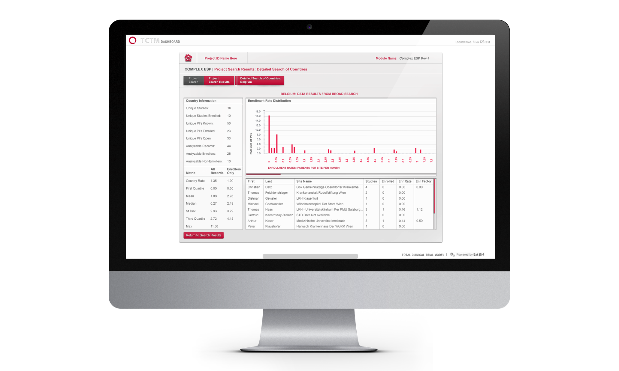
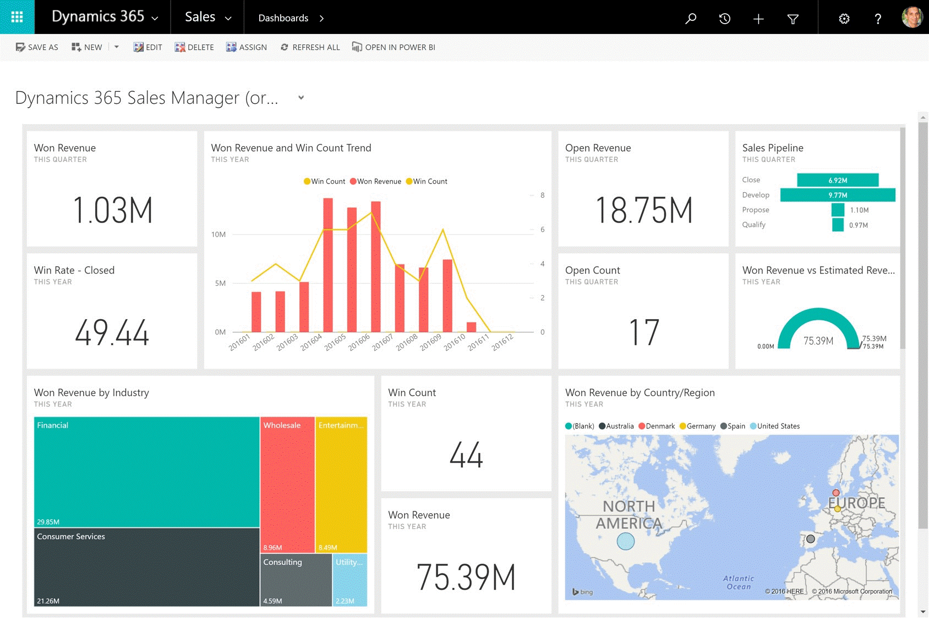
Dynamics Practice
Affirma's CRM Practice provides full service business and technology consulting to support our clients through the entire lifecycle of a CRM implementation. This includes business process optimization as our consultants evaluate and improve processes for sales, marketing, customer service and IT teams.
We help define business requirements and design innovative technical solutions to support them using the Dynamics platform. Our team has extensive experience implementing and supporting CRM solutions across a variety of industries and business models.
Business Process Optimization for Sales, Marketing, & Service
CRM Platform Evaluation & Selection
Requirements Definition, Technical Design
Implementation, Testing, Deployment
Training & Change Management
Ongoing Support & Managed Services

Slide 6
Company Overview
Breadth & Depth of Expertise
Our breadth and depth of capabilities across many technologies in the marketplace is a key differentiating factor that Affirma brings to the table. Alternative solutions comprised of individual contract employees or smaller teams will not provide the same level of quality assurance or continuity throughout your project.
This breadth and depth allows us to grow with our clients and become long term partners and trusted advisors. We support our clients’ growth and develop innovative solutions for their most challenging problems.
200+ Person Software Services team
CRM Development, Web Application Development, Business Intelligence, QA
25 Person UX/UI Design Agency
Design team working closely with our engineering teams
10 Person Infrastructure team
Experienced team of Infrastructure Engineers certified across in Microsoft, Amazon, and other technologies
15 Person PMO
Sr. Technical Project Managers with hands-on Salesforce Implementation, Managed Services, and IT project experience
80 Person Business Process Outsourcing Division
Support Analysts, Data Analysts, Team Leads

Slide 7
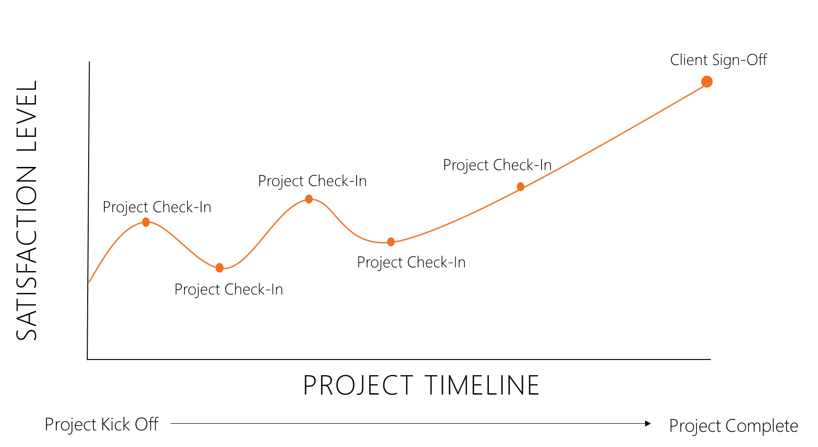
Customer Satisfaction
Customer Experience
Measure of client experience throughout the course of an engagement. This is a data driven metric, gathered every 2-3 weeks by Affirma Account Manager. Any client concerns, even minor points of feedback that arise are flagged and resolved immediately by the responsible General Manager and Practice Lead.
Customer Satisfaction
Measure of client satisfaction at the end of an engagement. This is a data driven metric, gathered by a 3rd party service after the completion of each project.

Slide 8










Clients

Slide 9
Relevant Work

Slide 10


Microsoft – XBOX Customer Support Dynamics 365
Business Need
Microsoft’s Xbox Customer Support team came to Affirma for help improving their customer service and case escalation processes. They had many siloed systems in place for triaging and escalating support cases placed by end users of Xbox. This resulted in fragmented communications, and almost no process automation or reporting.
What We Did
Affirma gathered requirements and recommended significant process improvements.
Our team then designed a solution on Dynamics 365 to support the entire lifecycle of support cases. This included intake, triage, communication, resolution and reporting.
Dynamics 365 was integrated with another Customer Support platform at Microsoft which is built on Azure Dev Ops (ADO).
Affirma performed extensive quality assurance on the Dynamics 365 solution across functionality and user roles. This included test planning, full QA, bug fixing, UAT, production testing, and ongoing support post-deployment for minor iterations.
Affirma continues to engage with the XBOX to enhance functionality and reporting as needed.

Slide 11

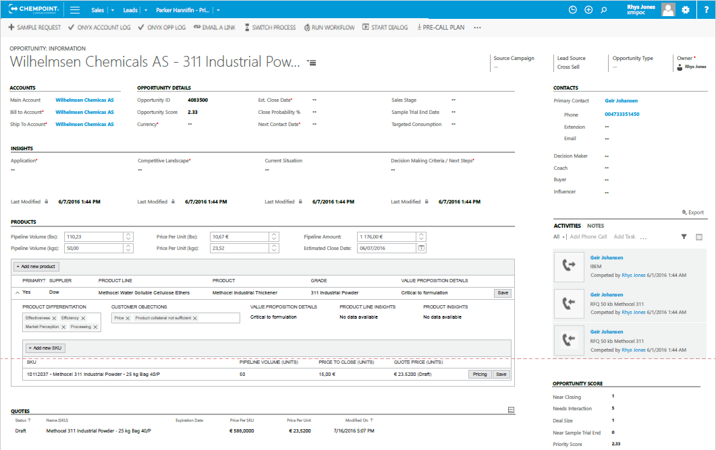
ChemPoint – CRM Redesign & Sales Analytics
Business Need
ChemPoint is a chemical sales, marketing and distribution company. They came to Affirma looking for support in redesigning their business processes for CRM across sales, pipeline management, and quoting. ChemPoint had goals to drastically improve sales management, forecasting, and user experience.
What We Did
Affirma produced comprehensive recommendations to standardize core sales processes, improve sales management, and streamline their forecasting and reporting processes with Dynamics CRM and Power BI.
Affirma worked with ChemPoint to implement these recommendations by reconfiguring Dynamics, and creating a series of Power BI dashboards to drive pipeline management and forecasting. Sales management used these reporting tools to measure lead to opportunity conversion, opportunity movement from stage to stage, win ratios, and stale data.
ChemPoint has rolled out Affirma’s recommended business processes and technical modifications to their Dynamics and Power BI solutions. They’ve experienced more streamlined communications, increased user adoption, and operational efficiency.

Slide 12
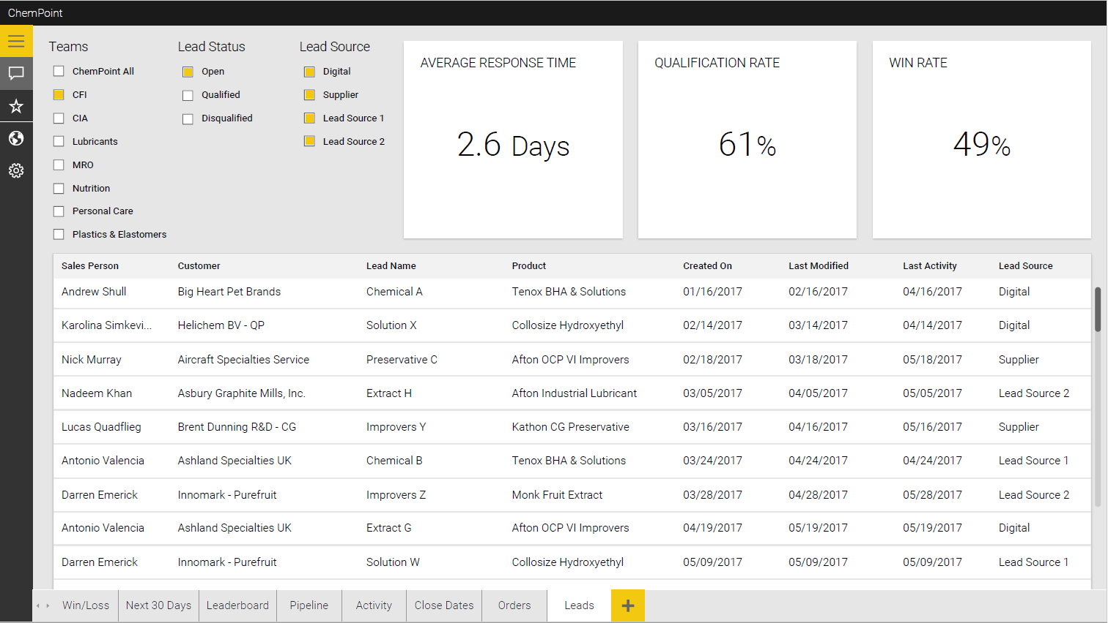
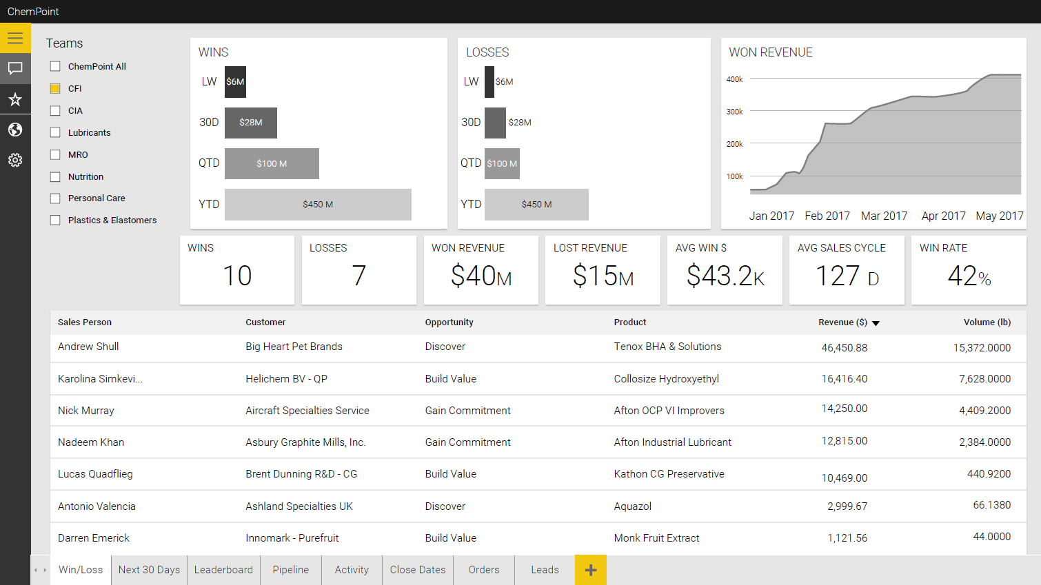
ChemPoint – Process Improvement & Sales Analytics

Slide 13
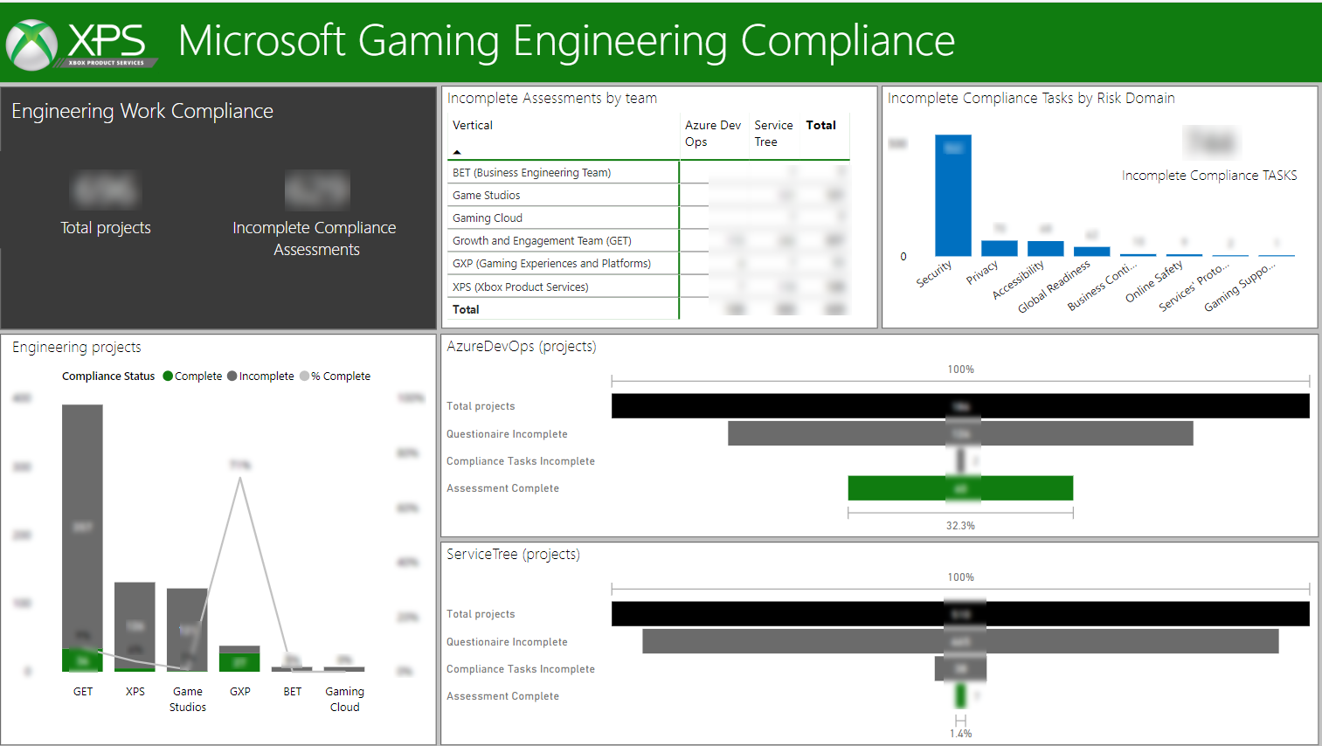
Microsoft – Gaming Compliance Reporting
What We Did
The Gaming Compliance program at Microsoft reached out to Affirma support in developing comprehensive reporting and analytics with Power BI.
The program’s leadership team needed to tell a story of accountability across the various engineering teams.
Affirma worked with them to review the data available across several source systems and determine the most impactful analysis that we could automate.
Power BI dashboards were created to manage the ongoing work of these teams, and ensure that compliance standards are consistently being met or exceeded across project lifecycles.
Primary metrics include completed tasks by team, complete/incomplete projects by team, and compliance achievement across programs.

Slide 14
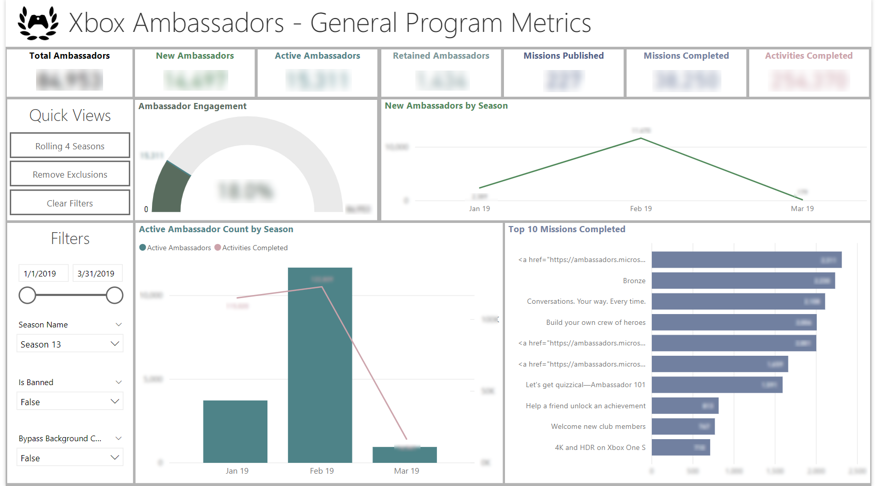
Microsoft – Xbox Ambassadors Program Analytics
What We Did
Affirma supports the Xbox Ambassadors (XA) program at Microsoft and one of their major initiatives was to gain insight into the programs growth, retention, and engagement of Ambassadors.
Affirma worked with the XA team define key metrics to help tell the story of the Ambassador lifecycle and the program’s growth.
Our team then developed a series of Power BI dashboards were created to show how these metrics change over time as ambassadors joined the program, engaged, and ultimately left the program.

Slide 15
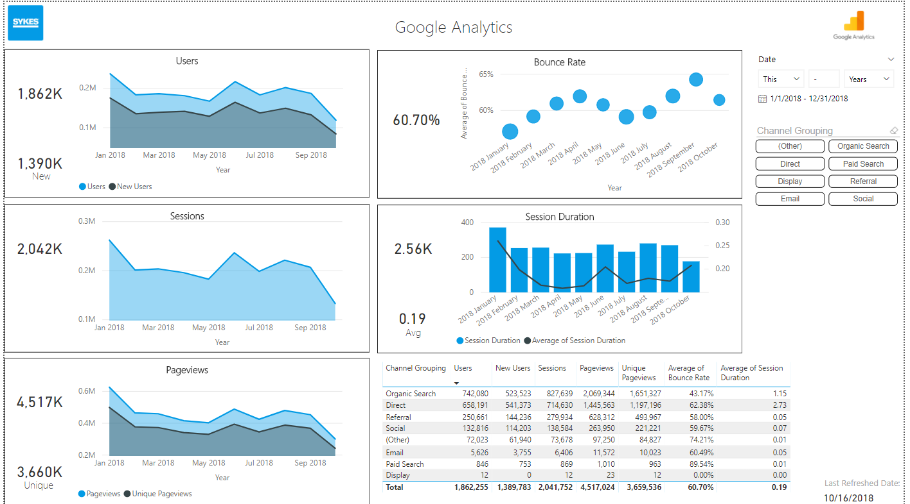
SYKES – Marketing Analytics with Power BI
What We Did
Affirma engaged with the Global Marketing team at SYKES to build analytics around campaign performance and marketing ROI.
This work included developing custom Power BI connectors for Twitter, Facebook, LinkedIn, and Google Analytics.
Their data was then summarized and sliced by campaign to help tell the story of how marketing strategy impacted performance across campaigns and events.

Slide 16

WA State Parks – Dynamics 365 Implementation
Business Need
Washington State Parks & Recreation selected Affirma to support their business transformation initiative and modernize their entire IT infrastructure using Dynamics CRM and Microsoft Business Intelligence platforms. The first project within this effort was implementing Dynamics 365 to automate a variety of manual processes within the Marine Law Enforcement program.
What We Did
Through our discovery, we identified a number of processes and forms to automate with Dynamics 365. Front-end web forms were created for Marine Law Enforcement officers to submit data which directly feeds into Dynamics 365.
Affirma worked with the Parks team to identify a number of different sources of where contact information was stored throughout the department. This data was centralized into Dynamics 365 to support improved data integrity, reporting, and communication.
Affirma performed extensive quality assurance on the web form solutions and Dynamics 365 environment. This included test planning, full QA, bug fixing, UAT, smoke testing in production, and ongoing support post-deployment.

Slide 17
Thank You

